Slide 1
SQL Server 2000 Internals
Locking – Part I
Ramkumar Murugesan

Slide 2
Locking – Part I
Components of Locking
Lock Modes
Lock Escalation
Identifying Lock Resources
Exercises
Manual Locking Hints

Slide 3
Next Section>>>
Components of Locking
Topics…
Locks and Latches | Lock Manager | Lock Duration | Lock Compatibility

Slide 4
Locks
Locking ensures transactional integrity and database consistency
Locking
  Prevents users from reading data being changed by other users
  Prevents multiple users from changing the same data at the same time
Either SQL Server or the developer can force Locking
Locks can be on these resources
  Database and File
  RID and Key range
  Table and Index
  Page and Extent

Slide 5
Latches
Latches are lightweight, short-term synchronization objects
Useful when objects need not be locked for the life of a transaction
Latches are less resource intensive than locks
Provides performance optimization
No system tables/procedures to track the latches. Can be tracked using performance monitors
Examples when a latching can happen…
  While transferring a row from storage engine to relational engine
  While traversing an index, root and intermediate pages of that index are to be protected from modification

Slide 6
Lock Manager
The SQL Server lock manager
  Acquires and Releases locks
  Manages compatibility between lock modes
  Resolves deadlocks
  Escalates locks if necessary
The lock manager provides two separate locking systems - locks and latches
Apart from locks and latches, lock manager uses spinlock for mutual exclusion
Spinlocks never lock user data

Slide 7
Lock Duration
The length of time that a lock can hold
Depends on the mode of the lock and the transaction isolation level
If your transaction isolation level is read committed,
  Shared locks are released as soon as SQL Server has read and processed the locked data
  An exclusive lock is held until the end of the transaction, whether it is committed or rolled back
  An update lock is also held until the end of the transaction
If your transaction isolation level is Repeatable Read or Serializable
  Shared locks have the same duration as exclusive locks They are not released until the transaction is over

Slide 8
Lock Ownership
Three types of lock owners
  Transactions
  Cursors
  Sessions
req_ownertype column in the syslockinfo table represents lock owners
req_ownertype - 1 represents transaction, 2 for cursors and 3 for sessions
Transaction lock owners

Slide 9
Lock Ownership
If a cursor is opened using a locking mode of SCROLL_LOCKS, a cursor lock is held on every row fetched until the next row is fetched or the cursor is closed
Even if the transaction commits before the next fetch, the cursor lock is not released
A session lock is one taken on behalf of a process that is outside the scope of a transaction
A process acquires a session lock on the database when it issues the USE database command, and that lock isn't released until another USE command is issued or until the session is disconnected

Slide 10
Next Section>>>
Lock Modes
Topics…
Shared Lock | Exclusive Lock | Update & Bulk Update Locks | Intent Lock | Schema Lock | Lock compatibility

Slide 11
Lock Modes
Shared Locks
  Shared locks allow concurrent transactions to read a resource
  No other transactions can modify the data while shared locks exist on the resource
  Shared locks on a resource are released as soon as the data has been read
Exclusive Locks
  Exclusive locks prevent access to a resource by concurrent transactions
  No other transactions can read or modify a data that is locked with an exclusive lock

Slide 12
Lock Modes
Update Locks
  Update locks prevent a common form of deadlock
  One transaction can obtain an update lock to a resource at a time
  A typical update pattern consists of a transaction
    Reading a record
    Acquiring a shared lock on the resource (page or row)
    Lock conversion to an exclusive lock
    Modify the row

Slide 13
Lock Modes
Bulk Update Locks
  A bulk update lock is acquired when…
    BULK INSERT command is executed
    bcp utility is run to load data into a table
    A copy operation uses the TABLOCK hint
  Prevent all other processes accessing the table
  If multiple connections have requested and received a bulk update lock, they can perform parallel loads into the same table

Slide 14
Lock Modes
Intent Locks
  Indicates that SQL Server wants to acquire a shared or exclusive lock on some of the resources lower down in the hierarchy
  For example, a shared intent lock placed at the table level means that a transaction intends to place shared locks on pages or rows within that table
  Intent locks improve performance because SQL Server examines intent locks only at the table level to determine if a transaction can safely acquire a lock on that table
  This removes the overhead to examine every row or page lock on the table to determine if a transaction can lock the entire table
  There are 3 types of Intent locks

Slide 15
Lock Modes
Intent shared (IS)
  Indicates the intention of a transaction to read some (not all) resources lower in the hierarchy by placing S locks on those individual resources
Intent exclusive (IX)
  Indicates the intention of a transaction to modify some (not all) resources lower in the hierarchy by placing X locks on those individual resources
Shared with intent exclusive (SIX)
  Indicates the intention of the transaction to read all the resources lower in the hierarchy and modify some (not all) resources lower in the hierarchy by placing IX locks on those individual resources
  Concurrent IS locks at the top-level resource are allowed

Slide 16
Lock Modes
Schema Locks
  Schema Modification (Sch-M) Locks
    Used when a table data definition language (DDL) operation is being performed
    E.g. Adding a column, dropping a table etc
  Schema stability (Sch-S) Locks
    Used when compiling queries
    They do not block any transactional locks (inc X locks)
    DDL operations cannot be performed on the table

Slide 17
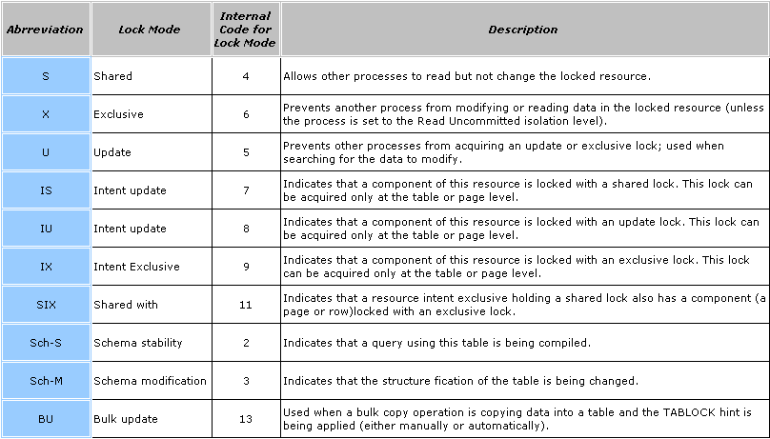
Lock Modes - Summary

Slide 18
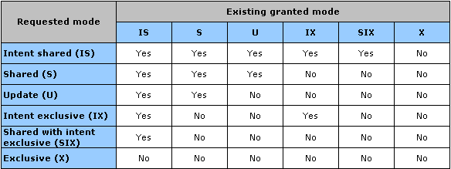
Locking – Compatibility
The schema stability (Sch-S) lock mode is compatible with all lock modes except the schema modification (Sch-M) lock mode
The schema modification (Sch-M) is incompatible with all lock modes
The bulk update (BU) lock modes is compatible only with schema stability and other bulk update (BU) lock modes

Slide 19
Next Section>>>
Special Locks
Topics…
Key Locks | Key Range Locks

Slide 20
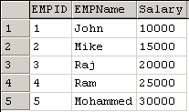
Special Locks - Key Locks
Two kinds of key locks based on the Current transaction’s isolation level
  If the isolation level is Read Committed or Repeatable Read, SQL Server tries to lock the actual index keys accessed
  If the isolation level is Serializable, SQL Server locks enough of the table to prevent phantoms This level of locking is termed as the key-range locks
SELECT * FROM Employee WHERE Salary BETWEEN 12000 AND 18000
For the above SELECT query, 10000 and 20000 would acquire key-range locks
This would prevent a insert on ranges ‘10000 and 15000’ and ‘15000 and 20000’ i.e. inserting 14000 (which is in the key range), as well as 19000 will be rejected

Slide 21
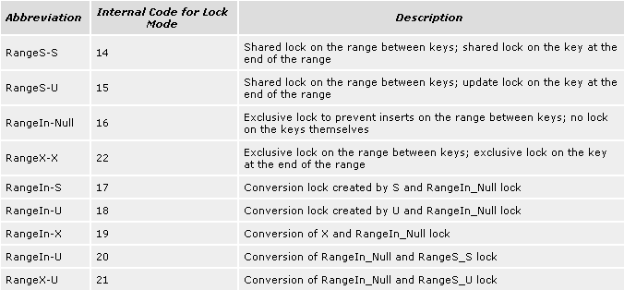
Special Locks - Key-Range Locks
There are nine types of key-range locks, and each has a two-part name
  The first part indicates the type of lock on the range of data between adjacent index keys
  The second part indicates the type of lock on the key itself

Slide 22
Next Section>>>
Lock Escalation
Topics…
Benefits of Lock Escalation | Algorithm for Lock Escalation | Lock Escalation Compatibility

Slide 23
Lock Escalation
Escalation is a process of increasing the hierarchy of a lock obtained
For example, after a query acquires many row locks, the lock can be escalated to a table lock if every row in a table must be visited
A single table lock is acquired and the many row locks are released
Escalation
  Reduces the number of locks in the system
  Reduces locking overhead and keeps the system from running out of locks
  Prevents the system from using too much memory for tracking locks
  Increases efficiency of the system by freeing up resources

Slide 24
Lock Escalation - Algorithm
SQL Server automatically escalates row, key, or page locks to coarser table locks as appropriate
The Lock Escalation algorithm is as follows…
Step 1: When the lock count for one transaction exceeds 1250 or when the lock count for one index or table scan exceeds 765, the lock manager looks to see how much memory is being used for all locks in the system in the next step
Step 2: If more than 40 percent of the memory pool is being used for locks, SQL Server attempts to escalate multiple page, key, or RID locks into a table lock

Slide 25
Lock Escalation – Compatibility
Table that is partially locked by a transaction, holds the largest number of locks and no escalation has already been performed are most preferred for escalation
Multiple RID, key, or page locks cannot be escalated to a table lock if some other processes hold incompatible locks on other RIDs, keys, or pages of the same table
SQL Server will keep looking for other tables partially locked by the same transaction until all possible escalations have taken place or the total memory used for locks drops under 40 percent
Note: SQL Server never escalates to page locks; the result of a lock escalation is always a table lock

Slide 26
Next Section>>>
Identifying Lock Resources
Topics…
Transaction types | Transaction Isolation Levels | Lock Manager | Lockable Resources

Slide 27
Types of Transaction
Auto Commit
  Every DDL/DML statement is auto committed
  Every statement opens a new transaction, commits when successful else rollbacks
Implicit Transactions
  In implicit transaction mode, SQL Server automatically starts a new transaction after the current transaction is committed or rolled back.
  Implicit transaction mode generates a continuous chain of transactions
  SET IMPLICIT_TRANSACTIONS ON | OFF
Explicit Transactions
  Manual way of representing transaction statements
  BEGIN TRANSACTION

Slide 28

Isolation Level
Four transaction Isolation levels
  Read uncommitted – Allows dirty reads
  Read committed – Prevents dirty reads but repeated reads can give inconsistent results
  Repeatable Read – Provides consistency for repeatable reads within a transaction
  Serializable – Transaction run in a Serializable mode under this isolation level

Slide 29
Identifying Lock Resources
When a lock is requested, Lock manager checks the syslockinfo table to find whether the resource is locked
If it is locked, Lock manager checks whether the requested lock is compatible with the existing one
Lock Manager compares locks by looking at the…
  Database ID (dbid)
  Object ID (objid)
  Type of resource locked
  Description of the specific resource referenced by the lock
If match found (if a resource is locked), the lock compatibility matrix is used to determine the compatibility between two locks

Slide 30
Identifying Lock Resources
When selecting from syslockinfo table, there would be a lock on database even if nobody is running any queries
These are always shared locks and are used by SQL Server for determining when a database is in use
SQL Server detects DB locks when determining whether a database can be dropped, restored, or closed
This doesn’t apply to master or tempdb, Since they cannot be dropped or closed
Tempdb cannot be restored. To restore the master, the entire server must be started in single-user mode. So, DB locks are unnecessary
In General, don’t attend to extent or database locks

Slide 31
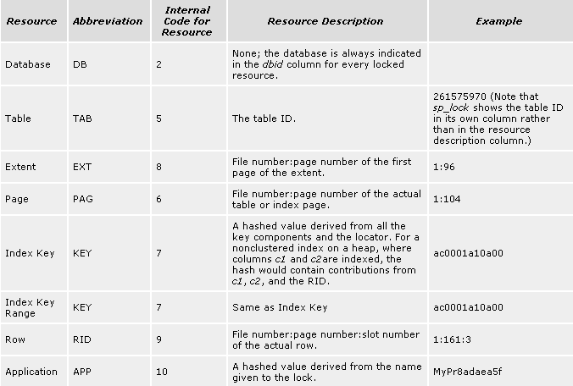
Identifying Lock Resources
Figure: Lockable Resources in SQL Server

Slide 32
Next Section>>>
Exercises – Part I
Topics…
Simulating Dirty Read | Repeatable Read | Phantom Read

Slide 33
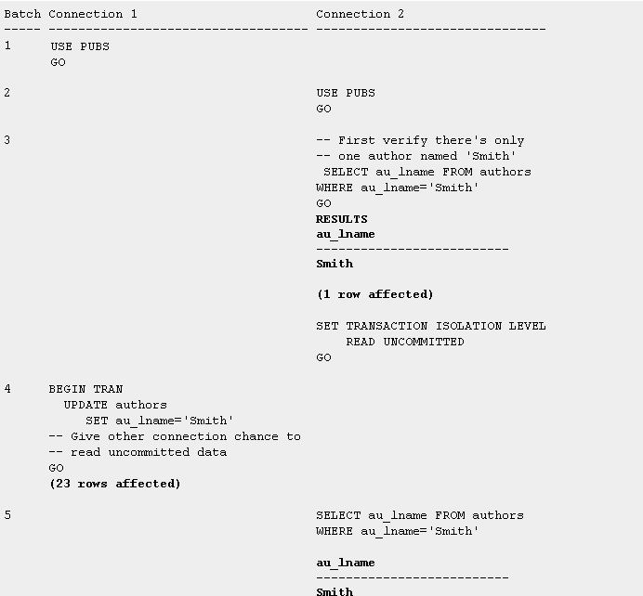
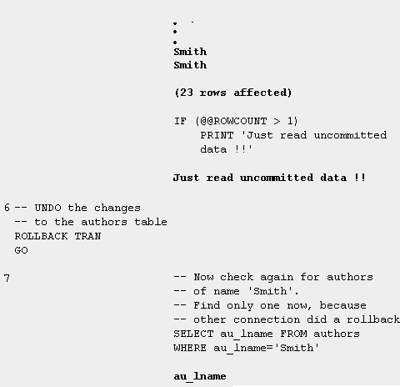
Exercises – Simulating Dirty Read
The update to Smith was never committed by connection1, yet the connection2 read it
Also, Connection2 didn't wait for the exclusive lock held by the first connection updating the data to be released

Slide 34
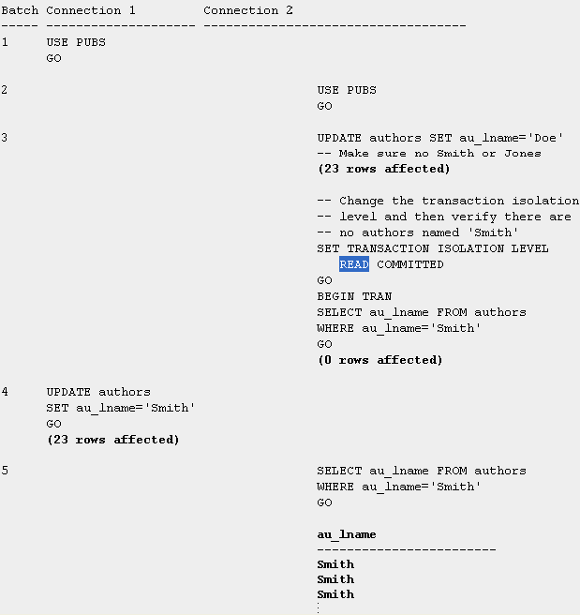
Exercises – Simulating Repeatable Read
When the isolation level was set to READ COMMITTED, selecting the same data twice within a transaction yielded totally different results:
first no Smiths were found, and then 23 of them appeared.
If this were a banking transaction, these results would be unacceptable.

Slide 35
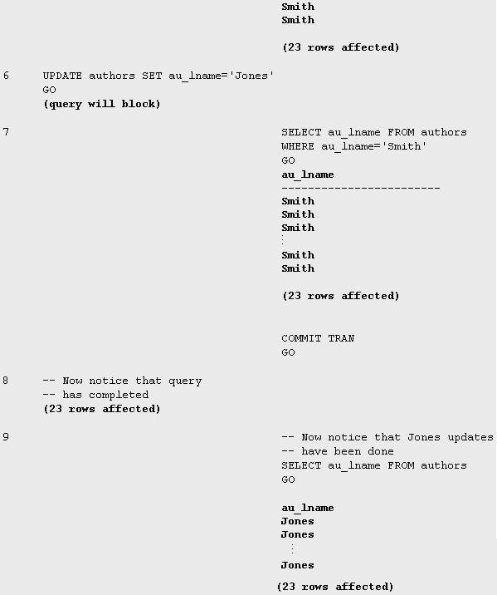
Exercises–Simulating Repeatable Read (continued)
Changing the isolation level to REPEATABLE READ, yielded with the same result (no Joneses) with both SELECT statements.

Slide 36
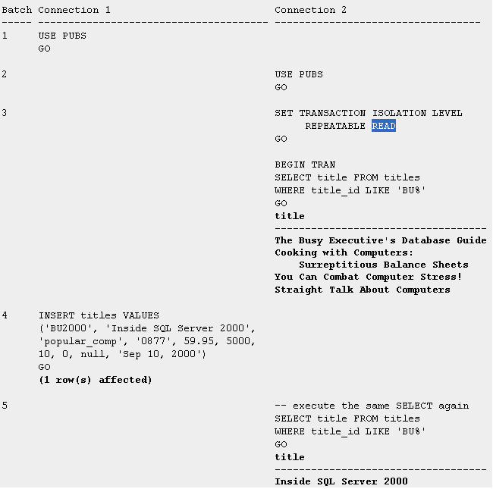
Exercises – Simulating Phantom Read

Slide 37
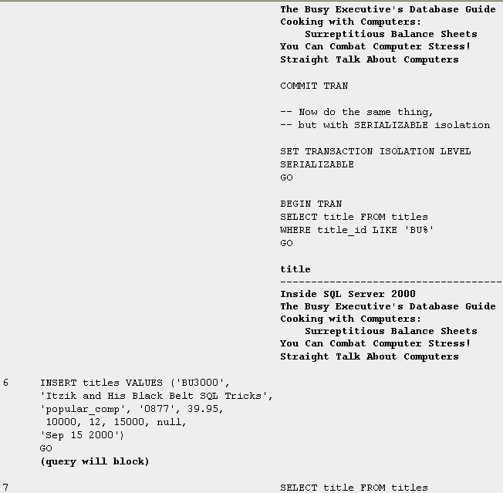
Exercises – Simulating Phantom Read
In REPEATABLE READ isolation level, phantoms were possible.
Another connection could add new data so that reissuing the same SELECT within a transaction would return more rows the second time.
In this example, the title “Inside SQL Server 2000” just mysteriously appeared; it's the phantom row

Slide 38
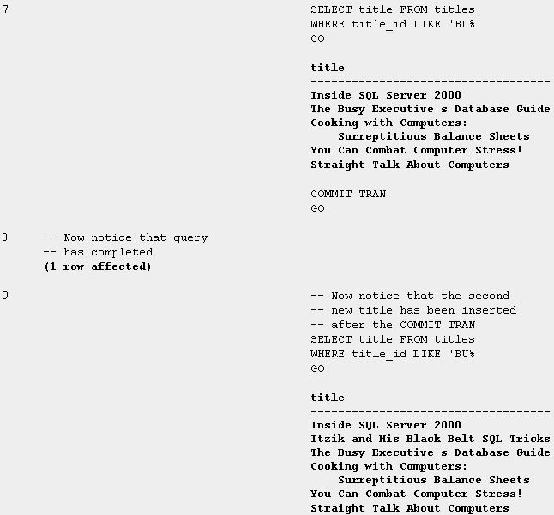
Exercises – Simulating Phantom Read
After changing the isolation level to SERIALIZABLE, the results were the same (five titles) for both SELECT statements in the second connection

Slide 39
Next Section>>>
Exercises – Part II
Topics…
Analyzing locks for SELECT/UPDATE/CREATE for various Isolation Levels and Indexes | Manual Lock Hints

Slide 40
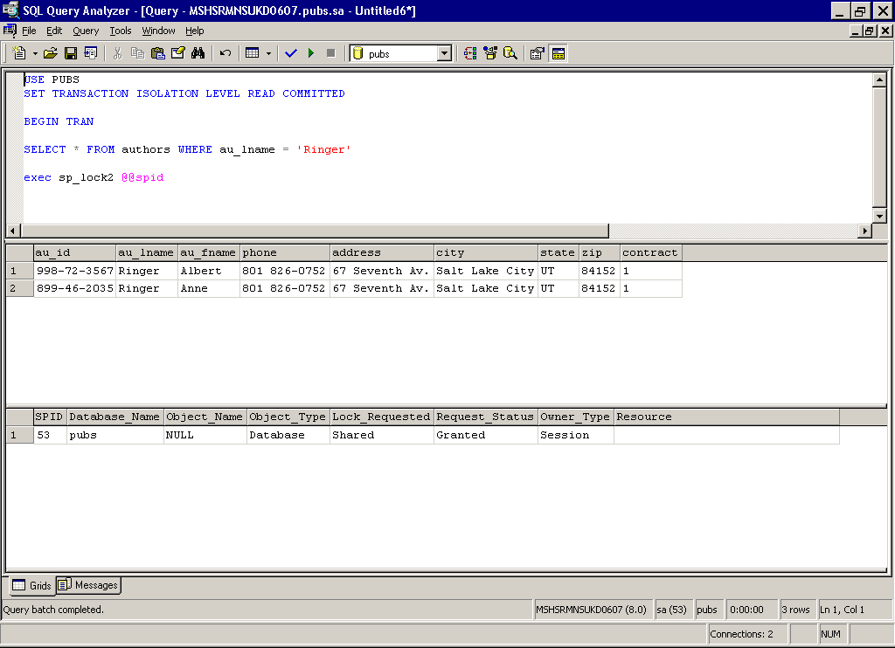

Exercise I
Figure: SELECT with Default Isolation level

Slide 41
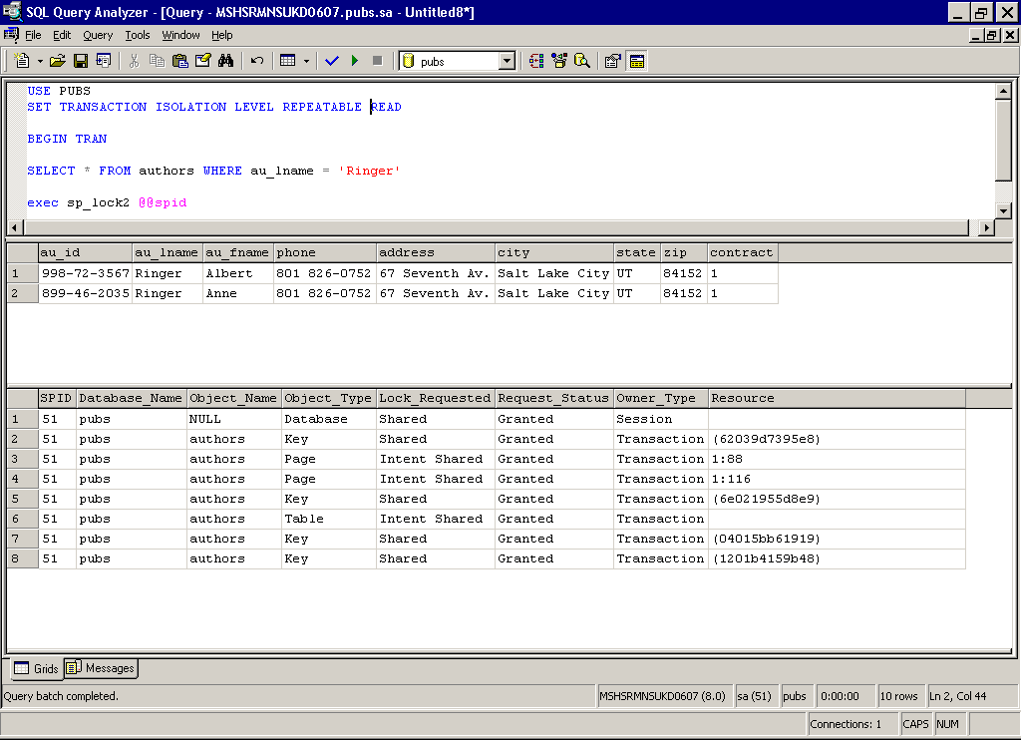
Exercise II
Figure: SELECT with Repeatable Read Isolation level

Slide 42
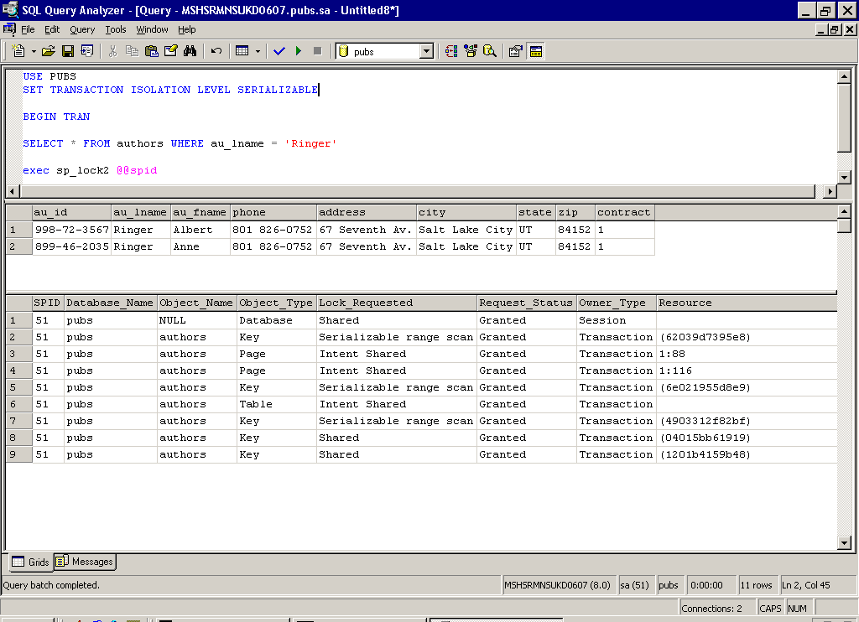
Exercise III
Figure: SELECT with Serializable Isolation level

Slide 43
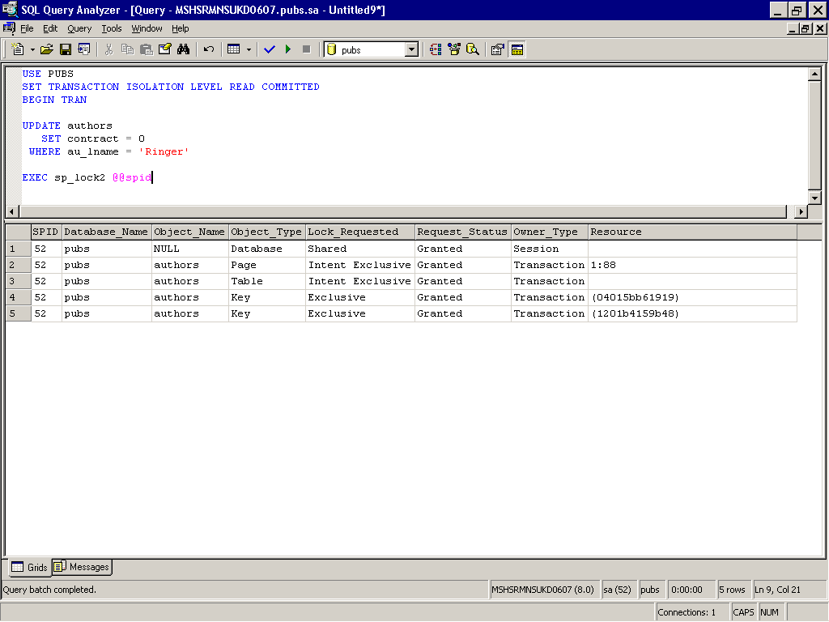
Exercise IV
Figure: UPDATE with Default Isolation level

Slide 44
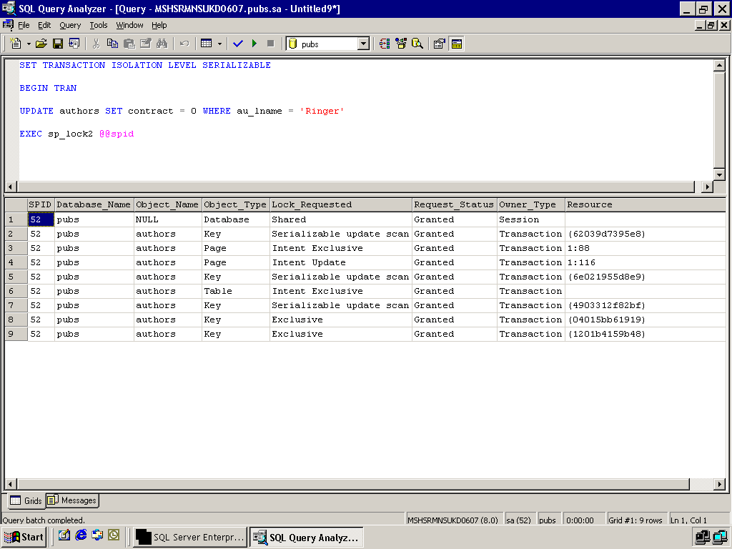
Exercise V
Figure: UPDATE with Serializable using Index

Slide 45
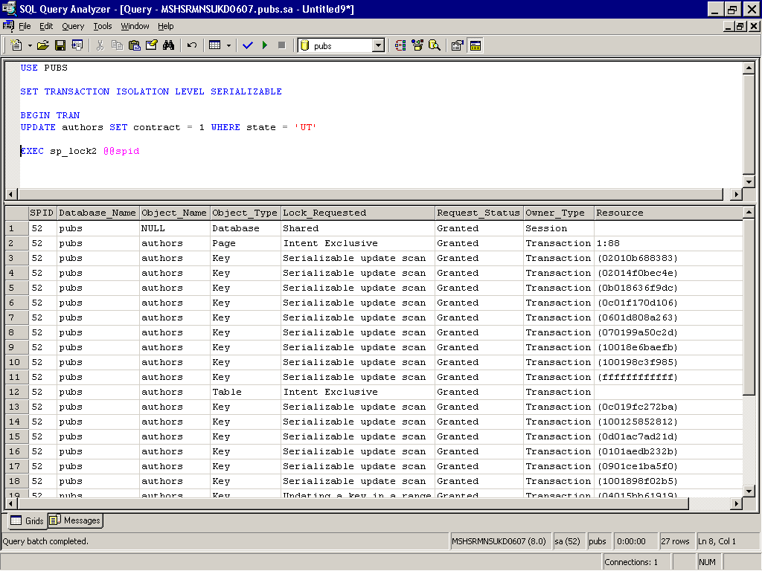
Exercise VI
Figure: UPDATE with Serializable without using index

Slide 46
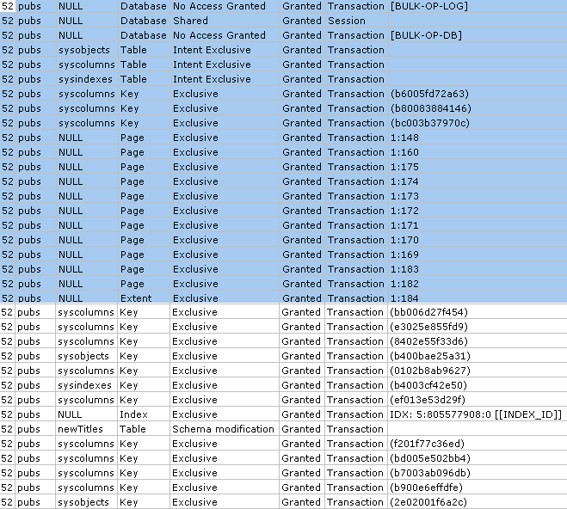
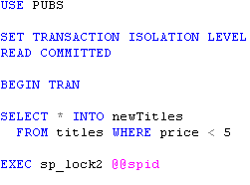
Exercise VII
Figure: Locks while Creating a table

Slide 47
Exercises for you
Run a SELECT under Serializable Isolation level in a window and Run UPDATE under Read committed in another window in parallel Analyze the locks that are acquired
Run an UPDATE under Serializable Isolation level in both windows and analyze the locks acquired

Slide 48
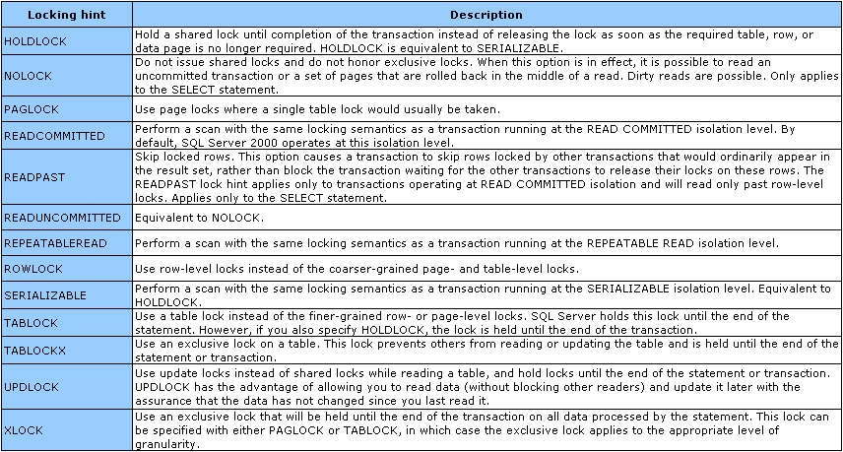
Manual Locking Hints

Slide 49
End of Topic – Locking Part I
?

Slide 50
End of Topic – Locking Part I
Thank you
Next Topic
Architecture Components | Storage Concepts | Transaction Logs | Indexes I | Indexes II | Locking I | Locking II | Query Processor

